Slide 1




PROBLEM SOLVING PROCESS
Class VIII
lab 7

Slide 2

Steps for Applied Thinking
1)decision making,
2)problem solving and
3)creative thinking.

Slide 3

Decision making
Decision making is about deciding what action to take; it usually involves choice between options

Slide 4

Decision making
leader who aspires to
excellence obviously
has a vested interest
in seeing that the best
decisions are taken

Slide 5

Decision making
you should become master of the processes of practical thinking,the processes that lie behind all effective decision making, problem solving and creative thinking

Slide 6
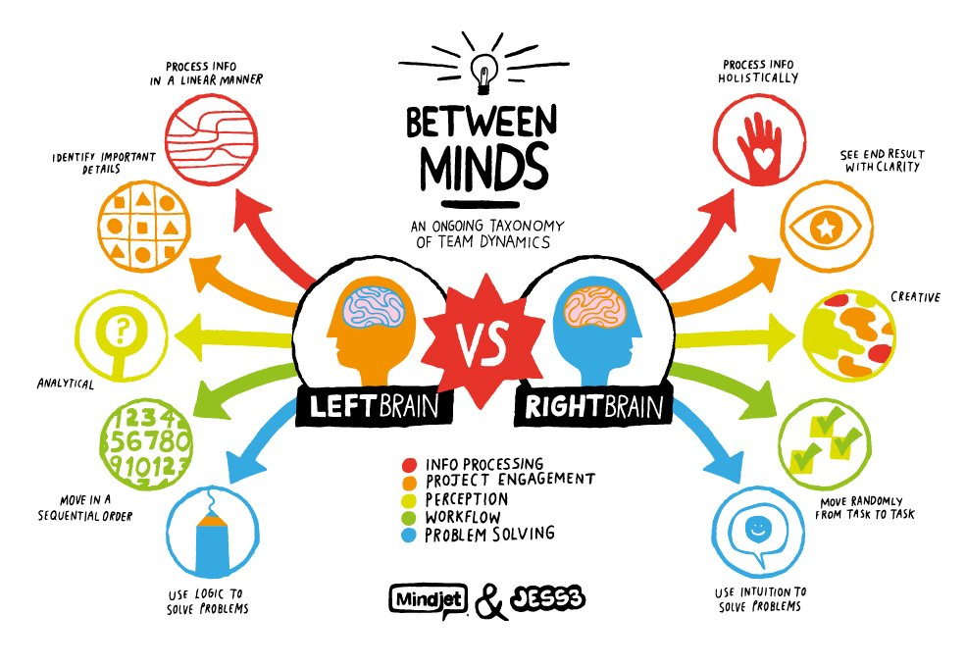
Is your brain working?

Slide 7

Use or Lose?
Use It
or Lose It
we will check that all your 10,000 million brain cells are warmed up and working properly

Slide 8



Slide 9

